Slide 1
GitHub basics
Cezary Winnik

Slide 2
Agenda
1. What is GitHub and version control system (VCS)
2. Creating a repository
3. Creating a branch
4. Making changes in a branch (commits)
5. Open a Pull Request (PR)
6. Merging a Pull Request
7. Github options
8. Summary
9. Helpful links

Slide 3
Version Control System (VCS)
- software tool
- keeps track of every modifiaction to the code
- most popular:
GitHub
GitLab
Bitbucket
Beanstalk
AWS CodeCommit

Slide 4
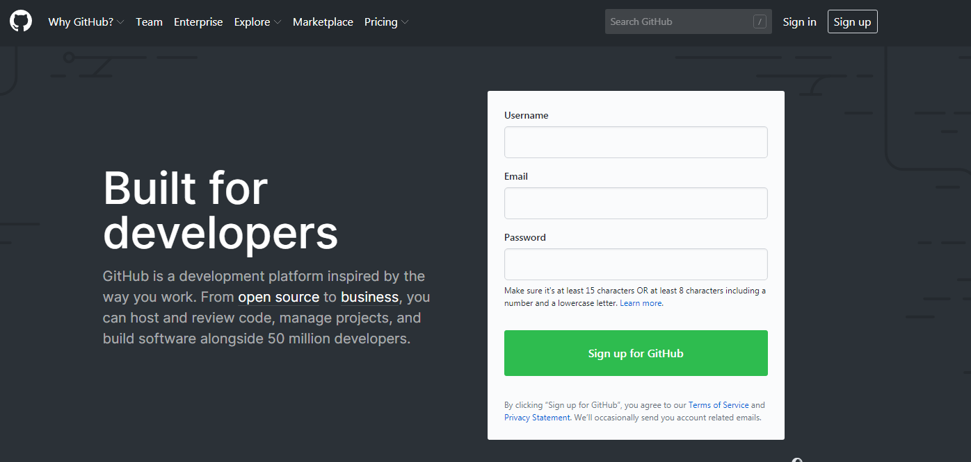
What is Github?
- version control system
- website
- service
Official site: https://github.com/

Slide 5
Creating a repository
Repository - folder for your project where you store all the files
What you can do with repository:
- create
- fork
- delete

Slide 6
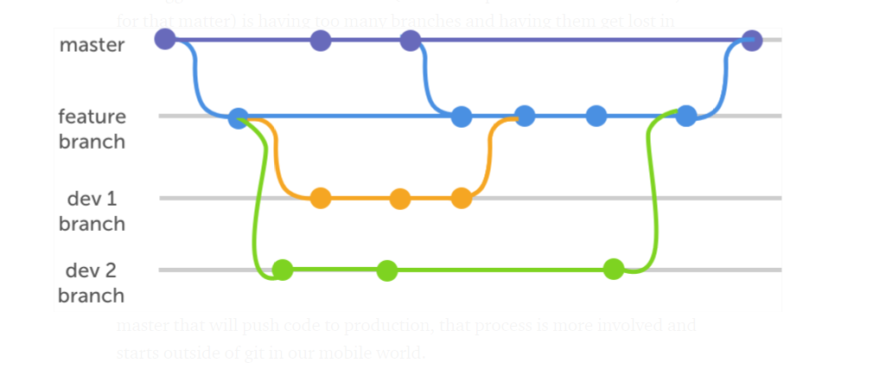
Creating a branch
Branch – copy of your repository where you can try out new ideas
What you can do with git branch:
- create
- delete
- commit
- merge

Slide 7
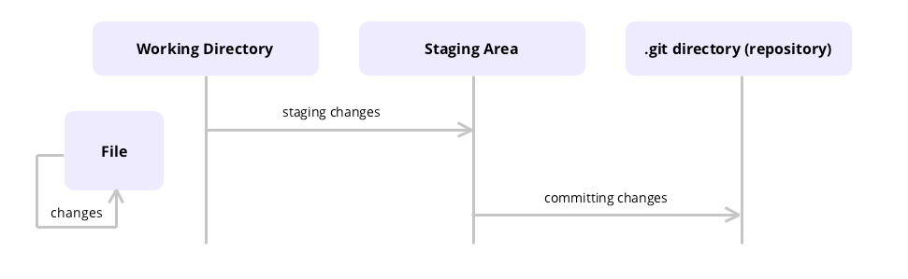
Making changes in a branch (commits)
Commit – a save of your created ideas

Slide 8
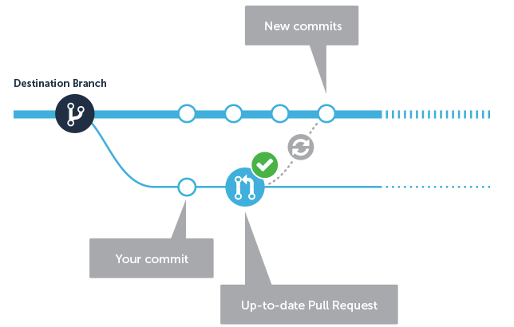
Open a Pull Request

Slide 9
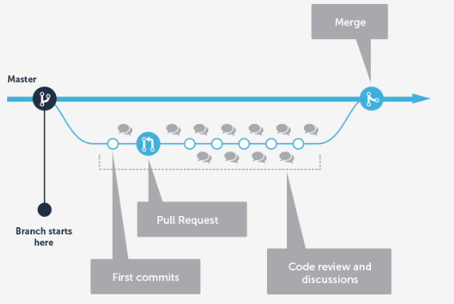
Merging a Pull Request

Slide 10
Github options
Repository visibility
Access to repository
Notifications
Forking policy
Renaming a repository
Transfering a repository
Deleting a repository
Restoring a repository

Slide 11
Summary
Github:
- version control system
- most popular in IT industry
- open source
- can be used by every one
- comes with git

Slide 12
Helpful links
https://try.github.io/ https://github.github.com/training-kit/downloads/github-git-cheat-sheet/ https://guides.github.com/introduction/git-handbook/ https://guides.github.com/

Slide 13
Thank you
cezary.winnik@ubs.com

